Slide 1
y
A
D
O
Alpha (<AB)
x
B
C

Slide 2


y
If checklength 1 is greater than checklength 2 the X-Pos of the point A is positive like described in the picture
If checklength 1 is smaller than checklength 2 the X-Pos of the point A is negative.
If checklength 1 is equal to checklength 2 point A is 0 – sits on the y-axis
Q
Checklength 1
A
Checklength 2
D
$$β$$
$$∝$$
P
x
O
Checklength2 is the half of the rectangle height
Checklength1 is the hypotenuse of the triangle POQ. – calculate with tan…
B
Given angle by the user
C

Slide 3



y
If checklength 1 is greater than checklength 2 the Y-Pos of the point B is negative like described in the picture
If checklength 1 is smaller than checklength 2 the Y-Pos of the point B is positive.
If checklength 1 is equal to checklength 2 point B is 0 – sits on the X-axis
A
Given angle by the user
D
$$∝$$
P
x
O
B
H
Checklength 2 is the half of the rectangle width
Checklength1 is the hypotenuse of the triangle HOG. – calculate with tan…
$$β$$
$$∝$$
Checklength 1
Checklength 2
G
C

Slide 4
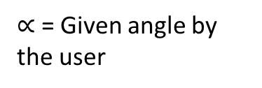

y
Calculating the A,C Positions
D
I
γ
F
C
O
δ
$$∝$$
x
δ (delta)=the angle we need to calculate with the rectangle OFA to get afterwards angle γ.
A
γ (gamma)=Angle to calculate with the rectangle OIA in order to calculate the position A
B
$∝$ = Given angle by the user

Slide 5



y
Calculating the B,D Positions
D
F
C
O
$$∝$$
$$∝$$
x
$$∝$$
A
$∝$ = Given angle by the user
B

Slide 6
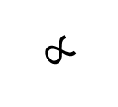
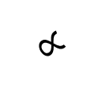
y
Calculating the B,D Positions
D
C
O
γ
x
δ
$$∝$$
$$∝$$
I
δ (delta)=the angle we need to calculate with the rectangle OFA to get afterwards angle γ.
A
F
γ (gamma)=Angle to calculate with the rectangle OIA in order to calculate the position B
B
$∝$ = Given angle by the user

